Slide 1

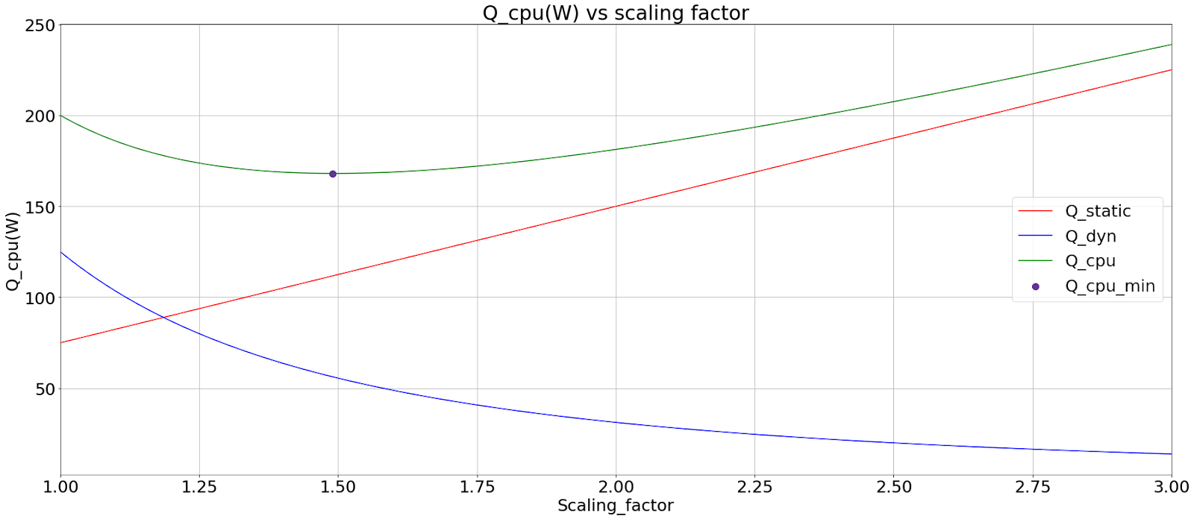
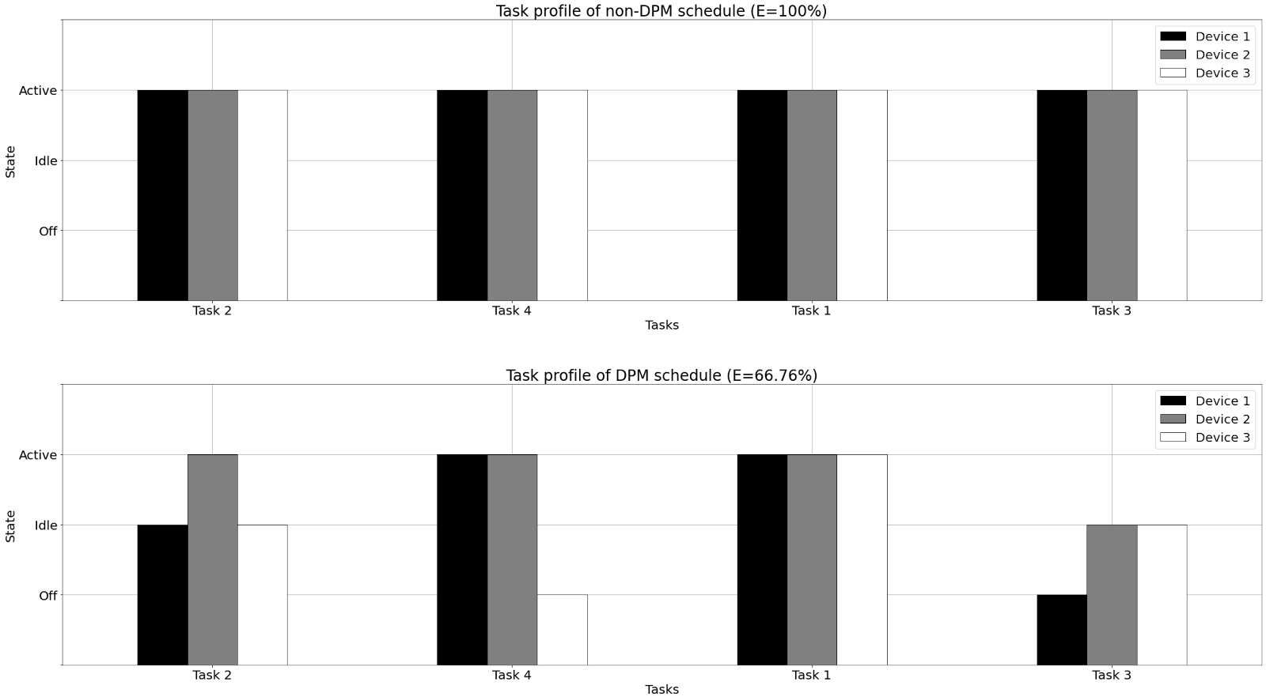
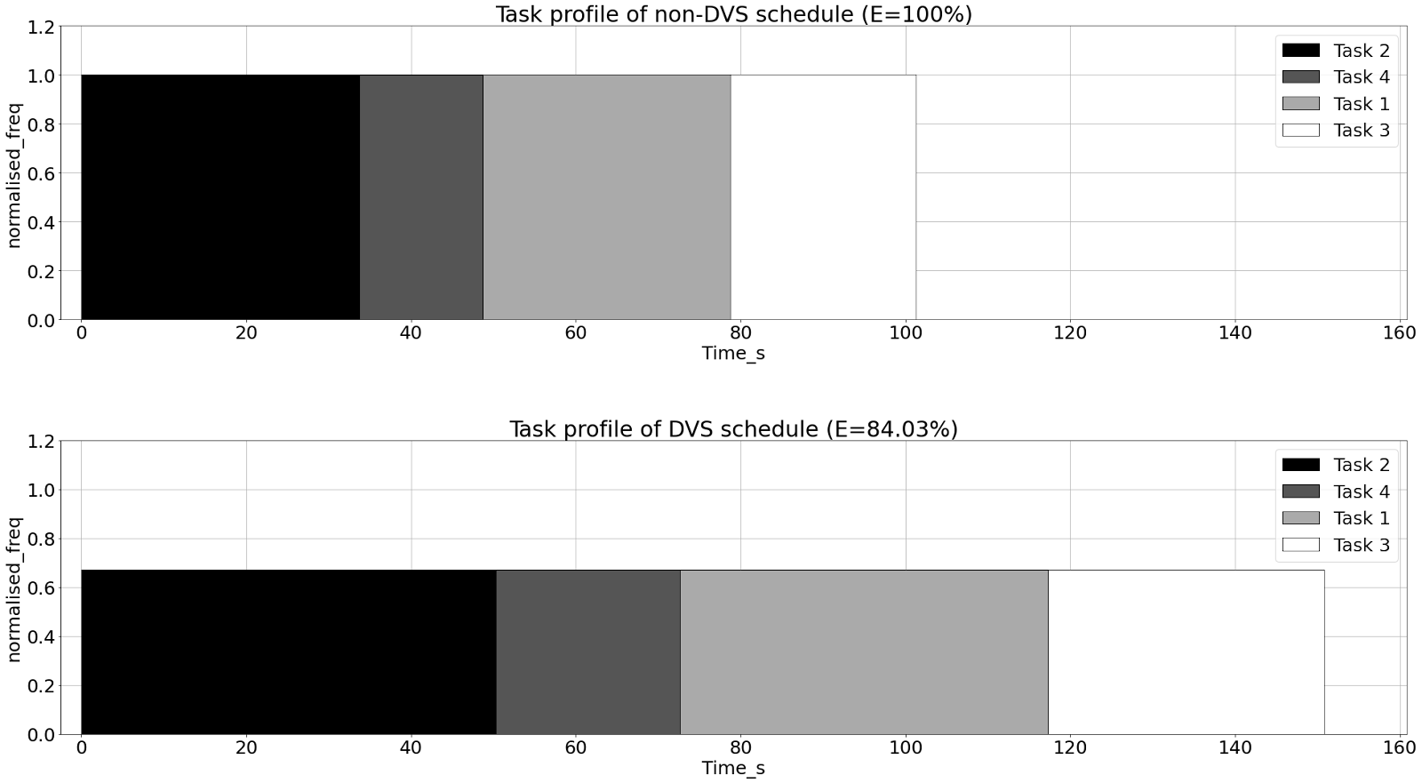
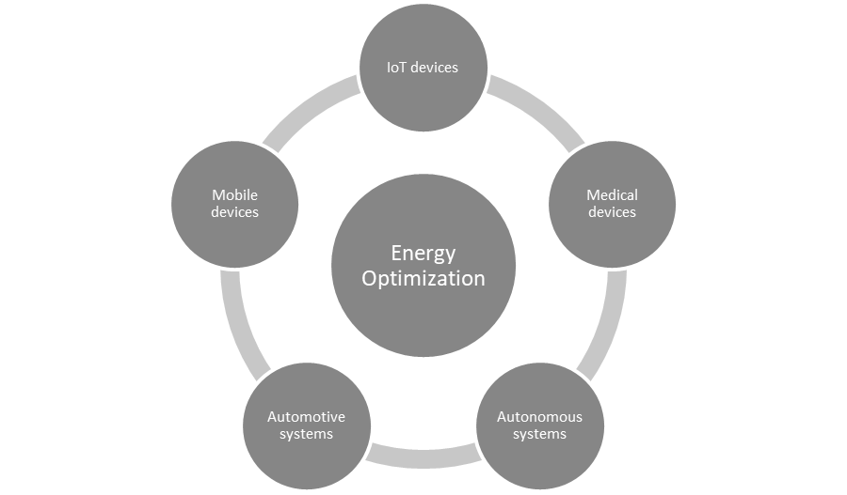
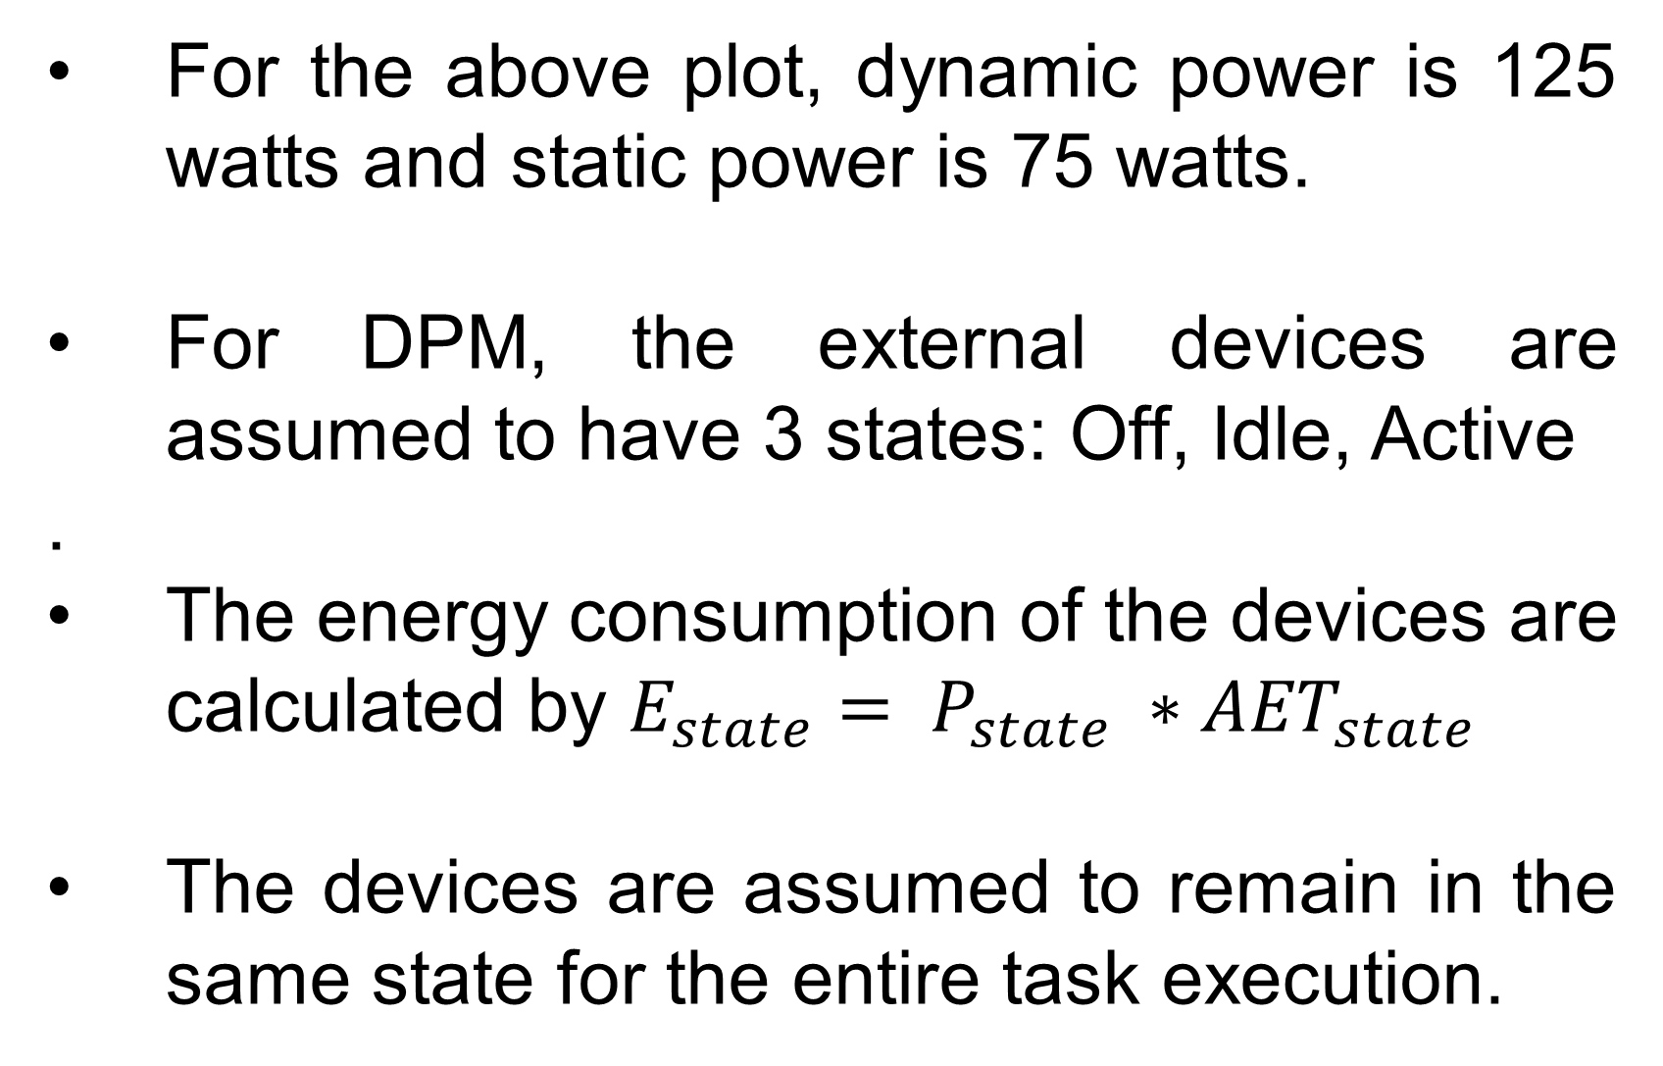
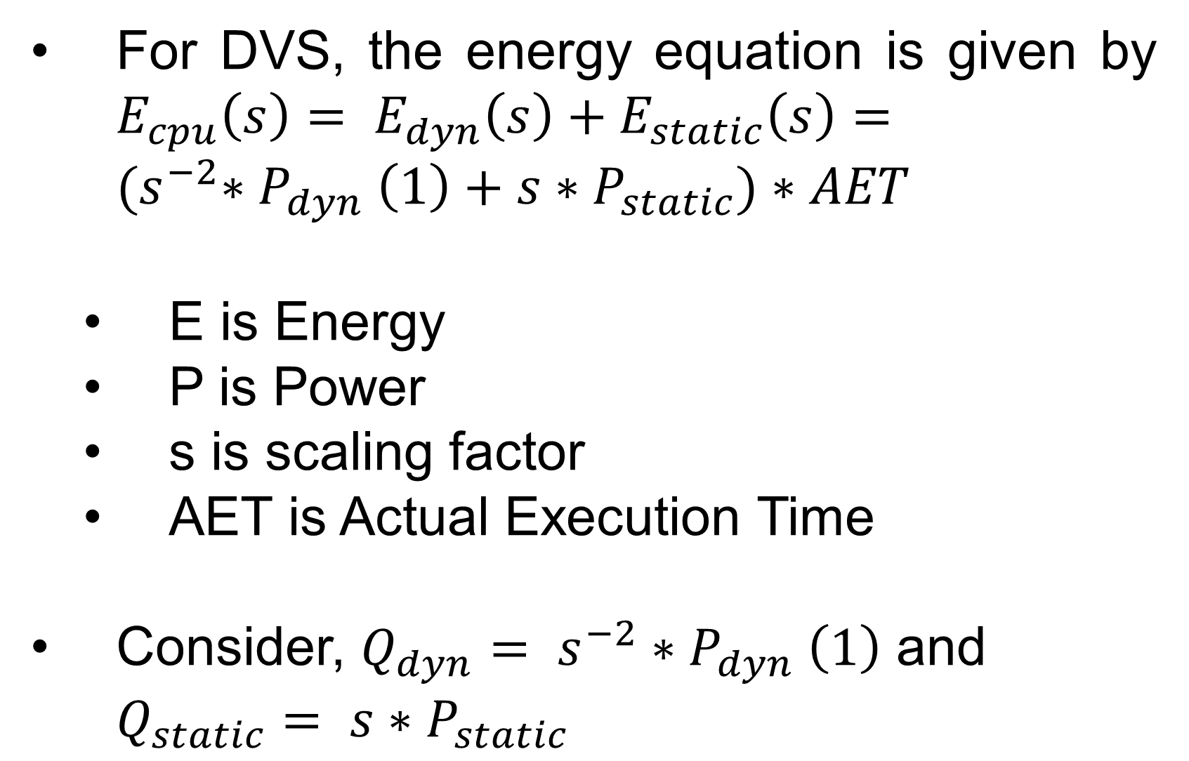
Optimization of energy consumption in battery-operated real-time systems
Swathi Konduru | Ashik Ahmed Bhuiyan
Computer Science Department
Objective
Methodology
Applying DVS increases the time it takes to complete tasks, as the processor runs at a lower frequency. However, this leads to a reduction in overall energy consumption.
The objective of this work is to:
Define an optimal model that optimizes/reduces the energy consumption in scheduling tasks.
Defining a suitable scheduling algorithm that works best with both DPM and DVS techniques
Comparing the performance of power management techniques such as DPM, DVS and the integration of both. This is an objective approach which can be scaled easily depending on the requirement.
Task definition
Scheduling the tasks based on LST
Calculating and tuning the performance of the devices
Calculation of energy saved or time of execution of tasks
Reference : https://www.azom.com/news.aspx?newsID=57834
Case Study: Dynamic Voltage Scaling and Dynamic Power Management
The tasks are defined by a task name, deadline, Worst Case Execution Time (WCET), Actual Execution Time (AET) which is less than WCET, priority assigned to it.
DVS model: The power of a CMOS circuit can be divided into static power, which is independent of the frequency and dynamic power, which is affected by frequency and voltage change.
DPM model: If there are a lot of external devices or sensors connected to the system then DPM is implemented to reduce the energy consumption by switching the states of inactive devices.
For the above plot, dynamic power is 125 watts and static power is 75 watts.
For DPM, the external devices are assumed to have 3 states: Off, Idle, Active
.
The energy consumption of the devices are calculated by $E_{state}= P_{state} ∗{AET}_{state}$
The devices are assumed to remain in the same state for the entire task execution.
Motivation
The total energy consumed by the devices is reduced to 66.76%. In this example, the processor is considered to be running at max frequency as DVS is not applied, as an effect the execution time is not scaled.
Battery-powered embedded systems face challenges such as limited battery life and poor performance without energy-saving techniques.
This study aims to develop a mathematical model to explore the effectiveness of DVS & DPM in optimizing battery usage for more efficient and sustainable battery-powered embedded systems.
Results
Mathematical Model
Conclusion & Future Scope
For DVS, the energy equation is given by $E_{cpu}\left(s\right)= E_{dyn}\left(s\right)+E_{static}\left(s\right)={(s}^{−2}{∗P}_{dyn}\left(1\right)+s{∗P}_{static})∗AET$
E is Energy
P is Power
s is scaling factor
AET is Actual Execution Time
Consider, ${Q_{dyn}= s}^{−2}{∗P}_{dyn}\left(1\right)$ and $Q_{static}= s{∗P}_{static}$
Through simulation-based experiments, optimal configurations for these techniques can be identified, contributing to the development of more efficient and sustainable battery-powered embedded systems.
Considering more real world parameters like efficiencies, effect of temperature
Experimental implementation and evaluation of the models
The frequency values are expressed as a proportion of the highest frequency
Fig 1. Use cases of proposed work

